Slide 1
Aws efs
ow

Slide 2
Introduction to Amazon EFS
Amazon Elastic File System (EFS) is a scalable, fully-managed cloud-based file storage service provided by Amazon Web Services (AWS).
It allows multiple EC2 instances to access a shared file system, which is ideal for use cases like web serving, content management, and data sharing across different applications.
EFS provides the flexibility and scalability required to handle dynamic workloads and offers high availability and durability by storing data redundantly across multiple Availability Zones (AZs).

Slide 3
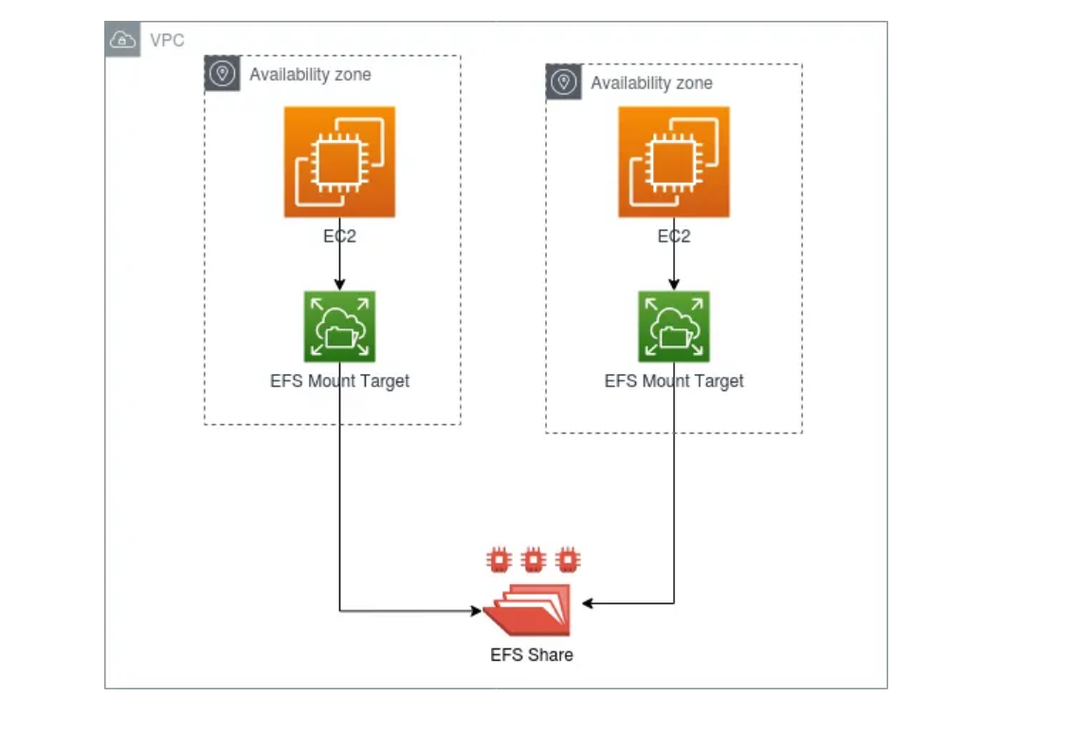
..

Slide 4
Key Features of Amazon EFS
Scalability: EFS automatically scales up or down as you add or remove files without any need for manual intervention.
Availability and Durability: Data is stored redundantly across multiple AZs.
Compatibility: Supports Network File System (NFS) protocol, making it compatible with various operating systems and applications.
Security: Integrates with AWS IAM, VPC, and AWS KMS for robust security measures.

Slide 5
Disadvantages of EBS that EFS Overcomes
While Amazon Elastic Block Store (EBS) is a reliable storage solution, it has some limitations:
Single Instance Attachment: EBS volumes can only be attached to a single EC2 instance at a time, limiting its use for shared storage scenarios.
Scalability: EBS requires manual intervention to resize volumes and adjust performance, which can be cumbersome and time-consuming.
Availability: EBS volumes are tied to a single Availability Zone (AZ), making them less resilient to AZ failures compared to EFS, which spans multiple AZs for high availability and durability.

Slide 6
lab

